Slide 1
MID-PROJECT PRESENTATION
FOR CERTIFICATE IN:
PATTERN RECOGNITIONS SYSTEMS (PRS)
OVER
OFFERING OVER
TRAINING OVER
6,250
GRADUATE
ALUMNI
150
ENTERPRISE IT, INNOVATION
& LEADERSHIP PROGRAMMES
135,000
DIGITAL LEADERS
& PROFESSIONALS

Slide 2

Private Healthcare Administration
Use Cases
Group 5
Ken Ly - A0032571N
Mok Kay Yong - A0214617J
Chong Keng Han - A0213547H
Harry Chan - A0213530X

Slide 3
Agenda
1. Background
Overall Background
Use Case #1: Prediction of Write-Off Cases
Use Case #2: Prediction of Patient Revenue based on Patient Country of Residence (COR)
Use Case #3 (Tentative): Hospital Bill Estimation Upon Patient Admission
2. Data Sets (Exploration and Cleaning) [2 mins]
3. Model Design, Observation, Preliminary Conclusion
3A: Use Case #1
3B: Use Case #2
3C: Use Case #3 (Tentative)
4. Deployment/Implementation Plan
5. Jupyter Notebook Demo/Highlights (if time allows or during Q&A)

Slide 4
Private Healthcare Administration
Use Cases
1. Background

Slide 5
1. Background
Private Healthcare Administration has to manage risks whilst accepting patients and providing treatment especially those cases on self pay (no insurance cover) and overseas patients cases
In 2019, Parkway embarked on AI project to predict Hospital Bill upon patient admission. This project won the best AI adoption award for Enterprise Category in SG Tech Blazer Award competition by Singapore IMDA
Using the same data set and some enhancement, the team has developed some additional use cases:
Use Case #1: prediction of write-off cases
Use Case #2: prediction of revenue number based on Patient COR
Use Case #3 (comparison): prediction of hospital bill upon patient admission

Slide 6
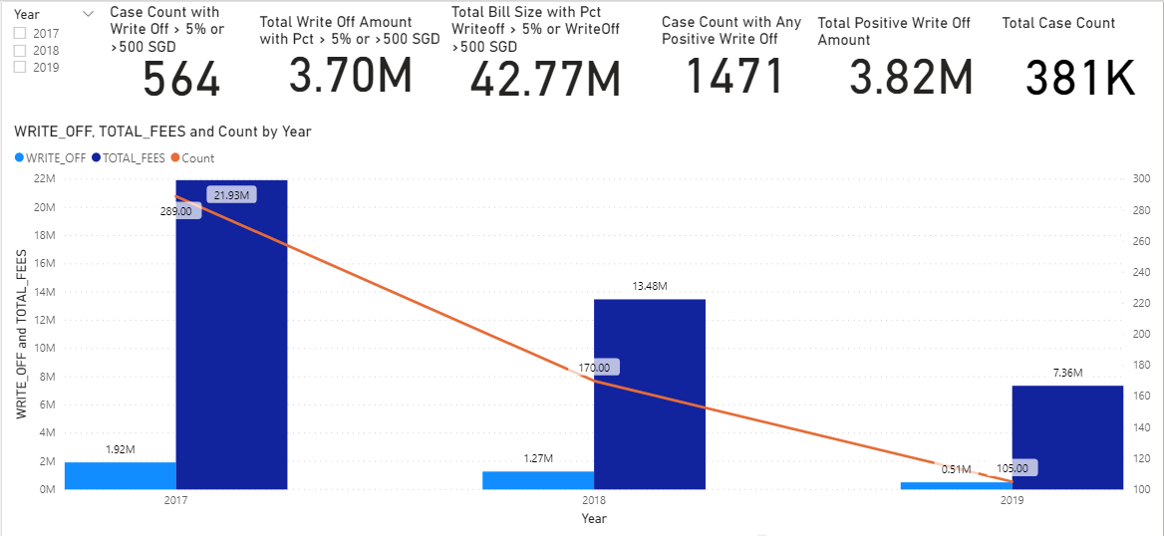
Use Case #1: Prediction of Write-Off Cases
Potential commercial applications:
To be incorporated into patients financial counseling process upon hospital admission
Cases identified as risky can go through more additional checks (similar concept as credit risk rating in banks or potential fraud in ecommerce context)

Slide 7
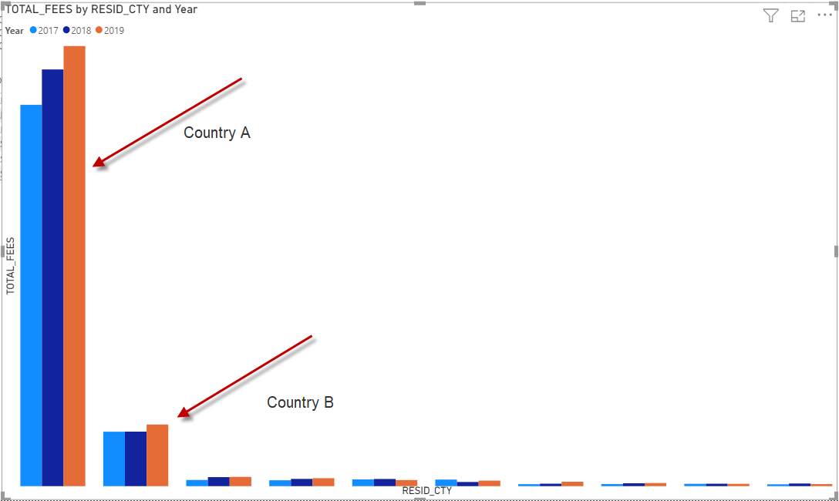
Use Case #2: Prediction of Patient Revenue based on Patient Country of Residence (COR)
Potential commercial applications:
Weekly Revenue Forecast for Top N Patient COR
The revenue forecast can help Marketing, Finance and Hospital Operation to plan for resources and set of proactive actions

Slide 8
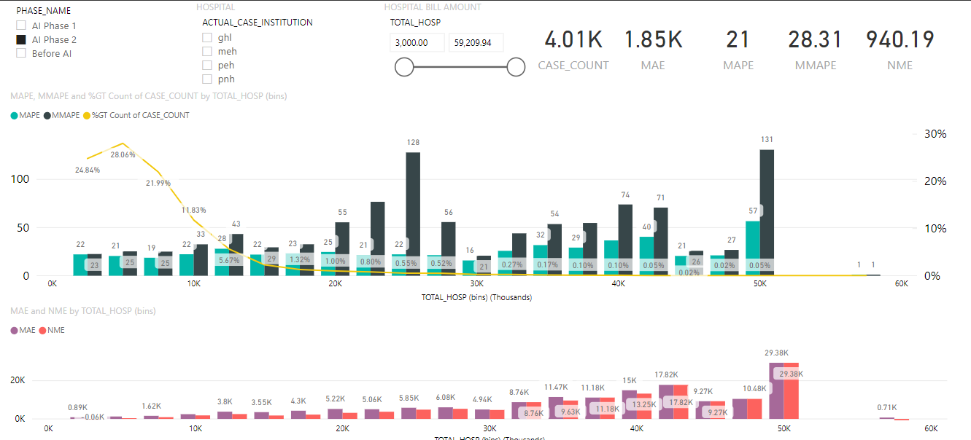
Use Case #3 (Tentative): Hospital Bill Estimation Upon Admission
Potential commercial applications:
To be compared against current model in production (which is a black box to Parkway)
To have more insights and ability to explain features impacting the estimate
Consistently low-error procedures can be marketed as fixed-fee upon admission, giving assurance to Patients and Insurers

Slide 9
Private Healthcare Administration
Use Cases
2. Data Sets
Exploration
Cleaning

Slide 10
2. Data Sets
Summarized Billing Data for 3 years from Jan 2017 - Dec 2019:
Data Set for Use Case #1 are the same file containing patient demography data, admission related data and some clinical information
Patient Demography: Date Of Birth, Citizenship, Country of Residence, Race, Religion, Gender, Marital Status
Admission Data: hospital code, case number, admission date, admitting doctor code, specialty, class/bed type, referral type
Discharge Data: clinical codes (ICD Code, TOSP Code, DRG Code), payer codes, professional fee, hospital fee, write off amount, length of stay (LOS)
Data Set for Use Case #2 is derived from the above. The revenue for country A and country B is formatted into weekly time series revenue data
Data Set for Use Case #3 has similar data set as above with some additional information:
Estimated codes upon admission (ICD and TOSP)
Estimated Length of Stay (LOS)
Estimated HDU/ICU stay

Slide 11
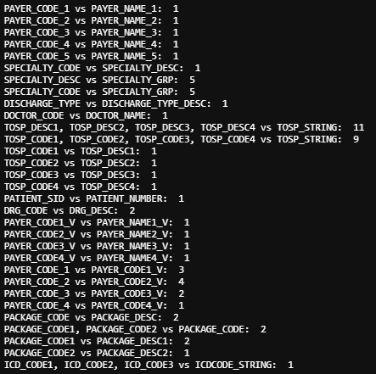
2. Data Sets (Exploration in jupyter notebook)
Find column to use as index → ‘CASE_NUMBER’
381210 unique values against total of 381211 values
duplicates removed
Compare features to check if they represent the same thing
df.groupby(by=['PAYER_CODE_1'])['PAYER_NAME_1'].nunique().max()
df.groupby(by=['ICD_CODE1', 'ICD_CODE2', 'ICD_CODE3'])['ICDCODE_STRING'].nunique().max()

Slide 12
2. Data Sets (Exploration in jupyter notebook)
Check for null values
Categorical features: replace null with empty string, ‘’
['PAYER_CODE_2', 'PAYER_CODE_3', 'PAYER_CODE_4', 'PAYER_CODE_5', 'REFERRAL_TYPE', 'DOCTOR_CODE', 'SPECIALTY_CODE', 'SPECIALTY_GRP', 'TOSP_CODE1', 'TOSP_CODE2', 'TOSP_CODE3', 'TOSP_CODE4', 'MARITAL_STATUS', 'RELIGION', 'RACE', 'DRG_CODE', 'PAYER_CODE2_V', 'PAYER_CODE3_V', 'PAYER_CODE4_V', 'PACKAGE_CODE1', 'PACKAGE_CODE2', 'ICD_CODE1', 'ICD_CODE2', 'ICD_CODE3', 'Resid_Cty_Code']
Numerical features: replace NaN with 0
['PACKAGE_PRICE', 'PACKAGE_EXCL', 'PACKAGE_ADJ']
Check if categorical features are read as numeric
['SPECIALTY_CODE', 'SPECIALTY_GRP', 'PACKAGE_CODE', 'PACKAGE_CODE1', 'PACKAGE_CODE2']

Slide 13
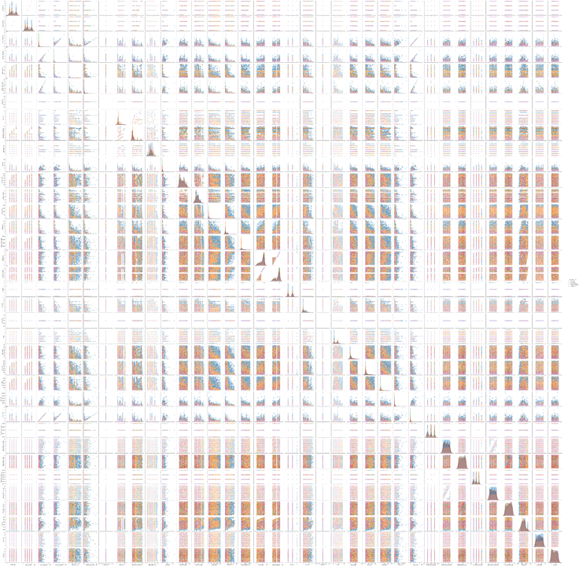
2. Data Sets (Exploration in jupyter notebook)
Use pair plots to view correlations and target distribution

Slide 14
2. Data Sets (Feature engineering)
Aggregate features
Length_of _stay = 'DISCHARGE_DTE' - 'ADMISSION_DTE'
Also represented by ‘LOS_DAYS’
Admission_Age = 'ADMISSION_DTE' - 'DOB'
Bin target column (‘WRITE_OFF’) for classification in use case #1
pd.cut(df[‘WRITE_OFF’], bin_intervals)
Simplify categorical features
Convert 'RESID_CTY' and 'RESID_POSTALCODE' to latitude and longitude

Slide 15
Private Healthcare Administration
Use Cases
3. Model Design, Observation and Preliminary Conclusion

Slide 16
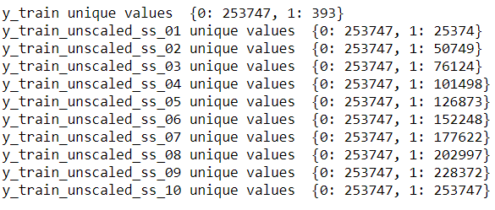
3A. Model Design, Observation and Preliminary Conclusion for Use Case #1
Model Design
Cases with significant Write-Off are quite rare: out of 380K total cases in 2017-2019, we are interested in identifying just 564 cases (about 0.15% only)
Due to the severe data imbalance, a technique called SMOTE (Synthetic Minority Oversampling Technique) is used to create synthetic training data for minority cases with sampling strategy ranging from 0.1, 0.2, 03, etc to 1.0. Note: SMOTE is not used at all for test data
Tested Models, without SMOTE and with SMOTE (with increasing sampling strategy):
Decision Tree (unscaled data)
Logistic Regression (scaled data)
Naive Bayes (scaled data)
Neural Net: MLPClassifier (scaled data), with various number of layers and number of neurons in each layer
KNN (scaled data)

Slide 17
3A. Model Design, Observation and Preliminary Conclusion for Use Case #1
Observation:
For Logistic Regression, Naive Bayesian and KNN Models:
SMOTE improves the model ability to detect write-off cases. The higher the sampling strategy ratio, the higher the number of minority cases that can be identified by the models
However as the improved detection for minority cases go up, so do the number of false positive cases
For Decision Tree Models:
SMOTE doesn’t really improve the detection for minority case (very marginal if any). The number of false positive case increases with SMOTE but it doesn’t really increase as the sampling strategy is raised from 0.1, 0,2 etc up to 1.0 (False positive case numbers are stable even though sampling strategy is increased)

Slide 18
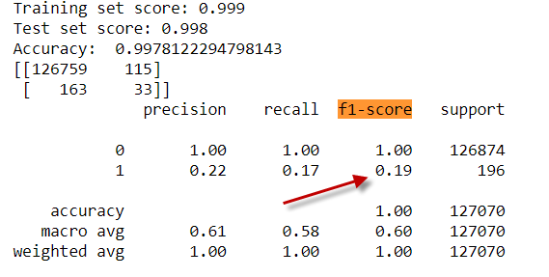
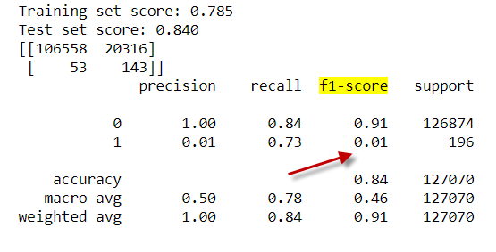
3A. Model Design, Observation and Preliminary Conclusion for Use Case #1
Observation:
For Neural Net MLPClassifier:
Neural Net models are good at balancing false positives and false negatives even with SMOTE
The minority case detection improves marginally with SMOTE but not significant and it doesn’t really increase as the sampling strategy ratio is increased
Preliminary Conclusion:
Logistics Regression and Naive Bayesian capability to detect minority cases can be improved with SMOTE. However this improvement is countered with the increase number of false positives
Decision Tree and Neural Net do not improve in a significant way with SMOTE in their capability to detect minority cases but these models are relatively more subdued / controlled in the increase of false positive cases (especially Neural Net). This is shown by the F1 score which is a combination score of precision and recall (Note: F1 Score = 2*Precision*Recall/(Precision+Recall) ). The F1 score for minority cases in Decision Tree and Neural Net models are better compared to Logistics Regression and Naive Bayesian models

Slide 19
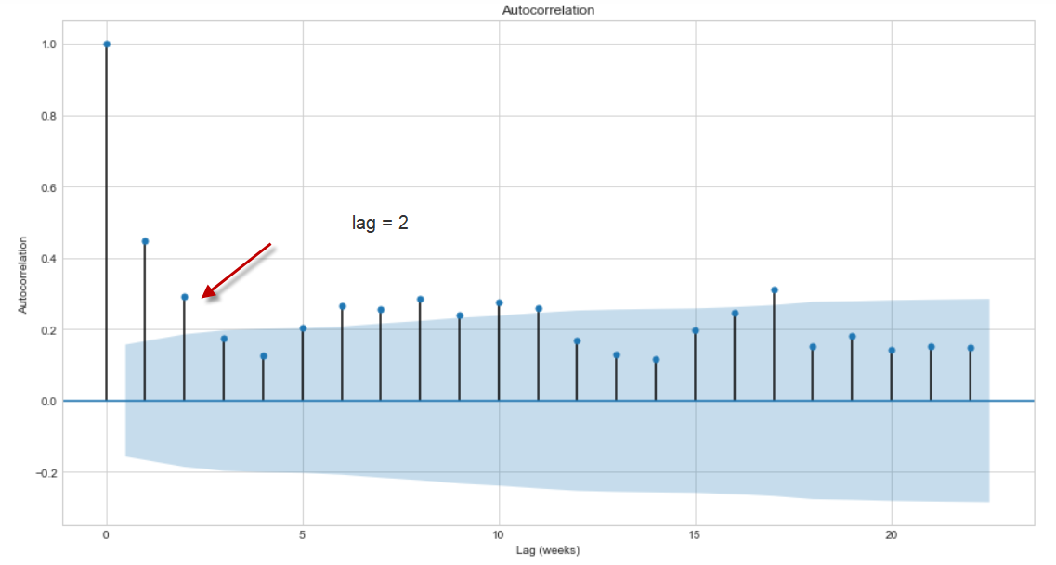
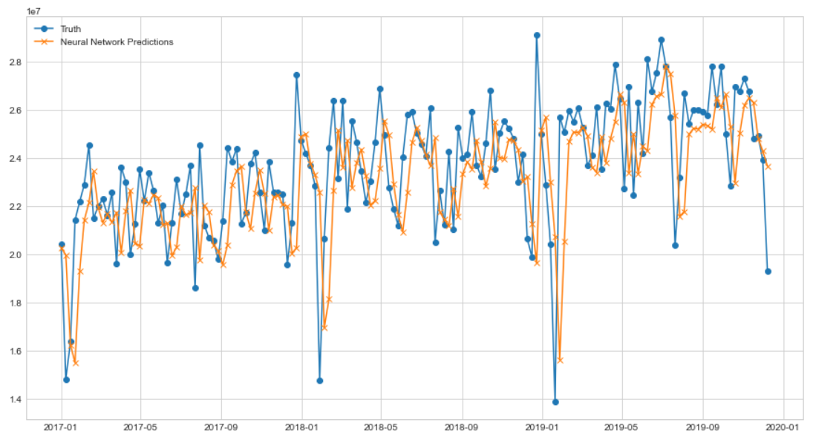
3B. Model Design, Observation and Preliminary Conclusion for Use Case #2
Model Design
The time series model is created for each of the top 2 Patient Country of Residence (Country A and Country B)
The models try to analyze the auto-correlation statistics and format the data set accordingly based on the best number of data lag to predict the future weekly revenue number
Sequential Neural Network using keras API is used for both models (different structure for country A and country B)
Observation:
For Country A:
Simple 2 layers Sequential Neural Net (16 nodes and 1 node) is able to achieve MAPE of 7.54%, suggesting revenue estimation accuracy of about 90% (100 - MAPE)
the model prediction is able to follow the ups and downs of the actual revenue pattern quite closely

Slide 20
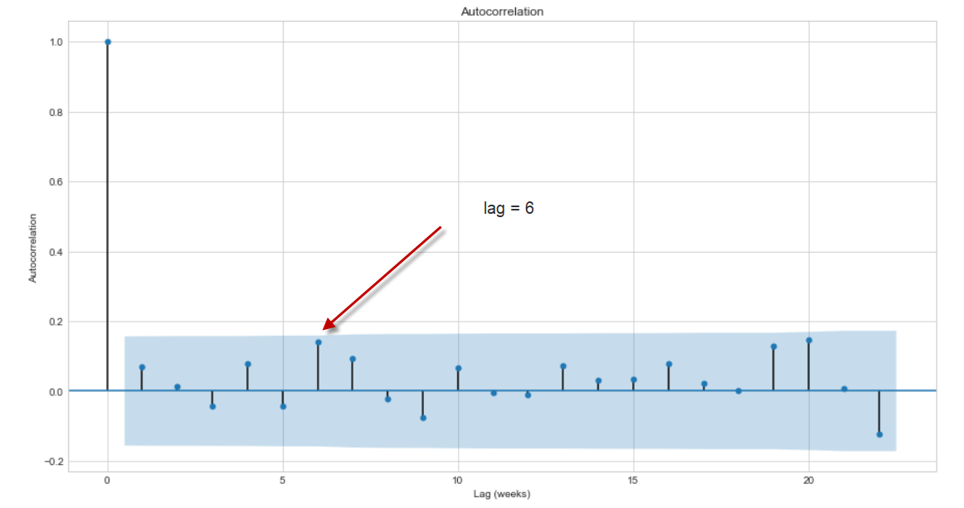
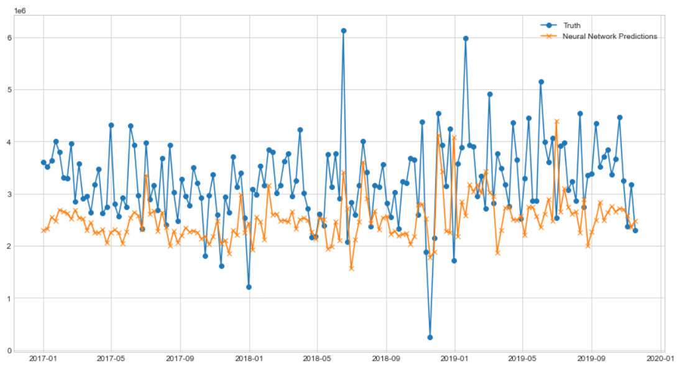
3B. Model Design, Observation and Preliminary Conclusion for Use Case #2
Observation:
For Country B:
The statistics show there is no good auto-correlation, so the model just uses the best auto-correlation lag (prior 6 weeks revenue to predict the following week revenue)
The above model is able to achieve validation MAPE of about 29%, suggesting revenue prediction accuracy of about 70%
Unlike country A, the model prediction for country B is not very good in following the ups and downs of the revenue pattern

Slide 21
3B. Model Design, Observation and Preliminary Conclusion for Use Case #2
Preliminary Conclusion:
Neural Net model is able to be used for prediction in time series data. This shows that even with the absence of meaningful business features in time-series data for the revenue prediction, neural net model can still perform self-learning and in a way indirectly keep the features hidden inside its layers and nodes structure.
If the data has good auto-correlation pattern, the simpler neural net structure can predict with quite good accuracy (ie in the case of country A, the model can achieve 7.5% MAPE). If the data shows more randomness (auto-correlation is not good), deeper layers of neural net and more nodes for each layer are required with some regulation (i.e. dropout at the early layer so that the weightage among the nodes can be more balanced

Slide 22
3C. Model Design, Observation and Preliminary Conclusion for Use Case #3
Model Design
A prediction of hospital bill with comparison with in-house product is performed using the below mentioned models. Error metrics of interest for the comparison will be
MAE : Mean Absolute Error
MSE : Mean Squared Error
RMSE: Root Mean Squared Error
MAPE: Mean Absolute Percentage Error
The MAE obtained via the in-house AI solution yields a MAE of 1.6K.
Tested Models:
Linear Regression
Neural Net
Ensemble Methods ( Random Forests Regressor & Gradient Boosting Regressor )

Slide 23
3C. Model Design, Observation and Preliminary Conclusion for Use Case #3
Observation:
For Linear Regression Model:
Provides reasonable results with the simple model
MAE: 2877, MSE: 109326959, RMSE: 10455, MAPE: 57%
For Neural Net Model:
Sequential model using MAE as the loss function
MAE: 4655, MSE: 181135885, RMSE: 13458, MAPE:
For Ensemble Models:
Random Forest Regressor
MAE: 2182, MSE: 61048576, RMSE: 7813, MAPE: 35%
Extreme Gradient Boost Regressor
MAE: 2306, MSE: 56360295, RMSE: 7507, MAPE: 47%

Slide 24
3C. Model Design, Observation and Preliminary Conclusion for Use Case #3
Preliminary Conclusion:
The Ensemble Models ( Random Forests / XGBoost )provides the best results among the tested models. This shows that a hybrid model would provide a better result compared to a simple linear regression model. The lower than expected results from the neural network may be resultant of a overfitting situation, thus further fine-tuning of the hyperparameters will be required to obtain a comparable model.
Interestingly, even though the Ensemble Models yields the best error metrics, the linear regression model is not too far off.
( Random Forests regressor MAE: 2.2K versus Linear regression MAE: 2.8K )
Thus, given a regression problem, a good starting point would be with a simple Linear regression model without an overkill solution.

Slide 25
Private Healthcare Administration
Use Cases
4. Deployment/Implementation Plan

Slide 26
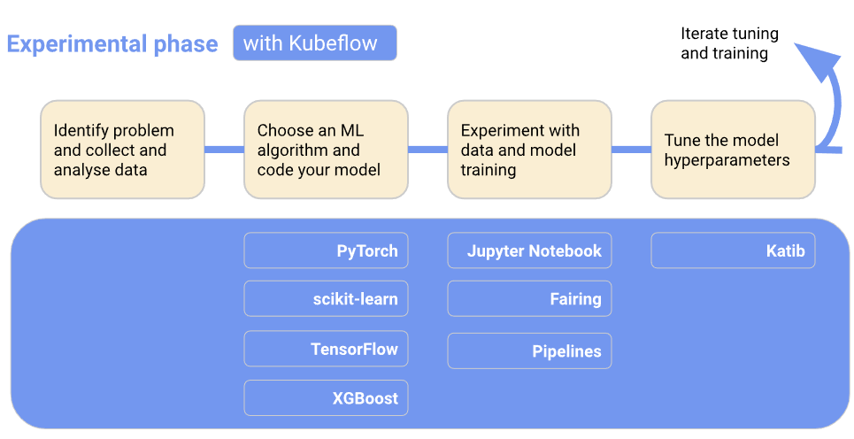

Slide 27
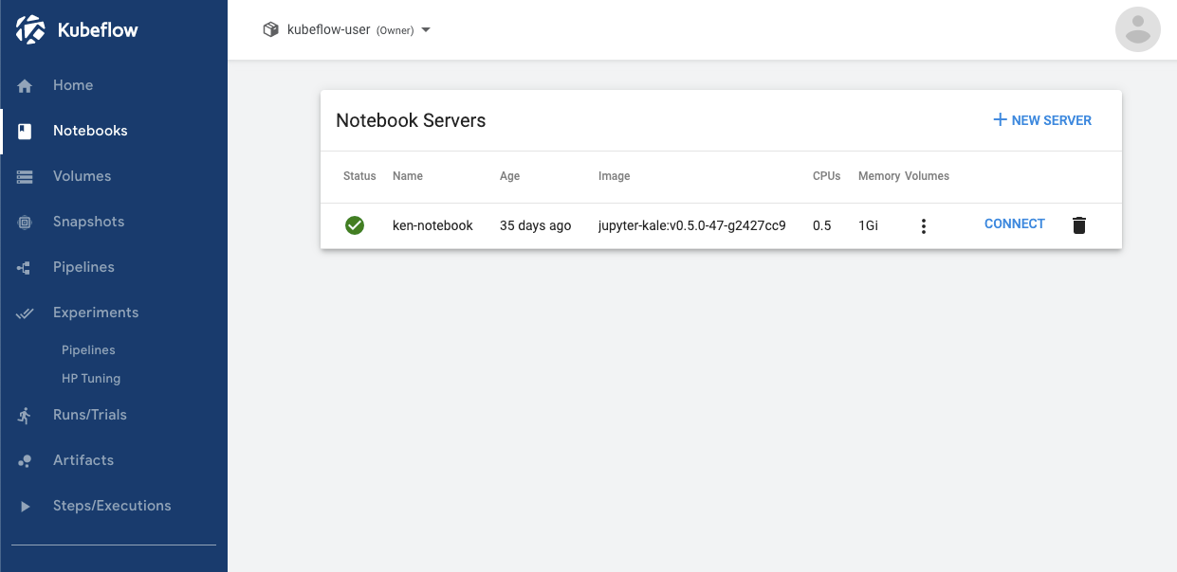
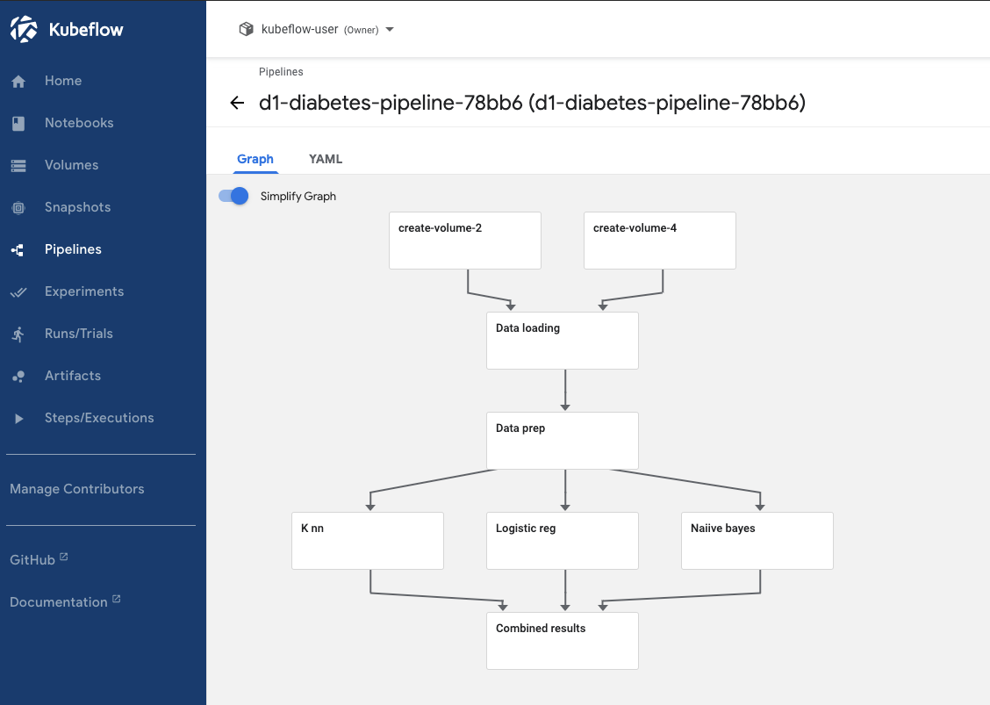

Slide 28
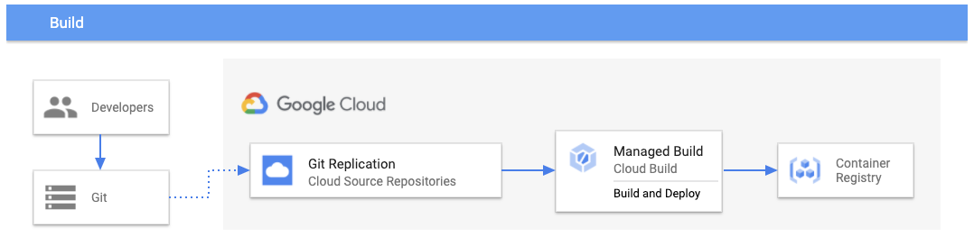
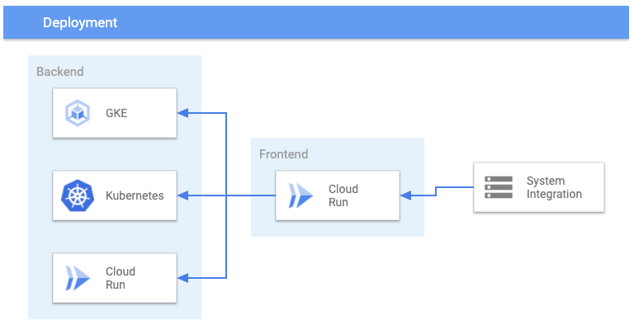

Slide 29
Private Healthcare Administration
Use Cases
5. Jupyter Notebook Demo/Highlights (if time allows)

